Slide 1
configuring openvpn server on ubuntu ec2 with certificate authentication
Prepare by : Parashurama

Slide 2
❗ Without the certificates, you CANNOT connect to VPN
To use OpenVPN, you must have:
  ca.crt
  server.crt
  server.key
  client.crt
  client.key
  dh.pem
  Optional: ta.key
  Since EC2 was deleted → these files are gone.
Can you delete the EC2 instance after creating copy of certificates?
Yes, because Easy-RSA only generates certificate files.
If you downloaded & saved those files to your laptop safely, you can use them anywhere.
But… You cannot run the VPN server unless you create a new EC2 instance and upload the certificates there.

Slide 3
Adding a certificate to a VPN
Adding a certificate to a VPN means importing the client certificate, client private key, and CA certificate generated by Easy-RSA into your VPN client software so that the VPN can authenticate and securely connect to the server.
Why it is used
  Provides strong security
  Prevents unauthorized access
  Ensures encrypted communication
  Safer than username/password
How it works
Easy-RSA creates:
  CA certificate (ca.crt)
  Server certificate + key
  Client certificate + key
VPN VPN server trusts certificates signed by your CA.
Client uses:
  client.crt
  client.key
  ca.crt
If certificates match → VPN connection successful.

Slide 4
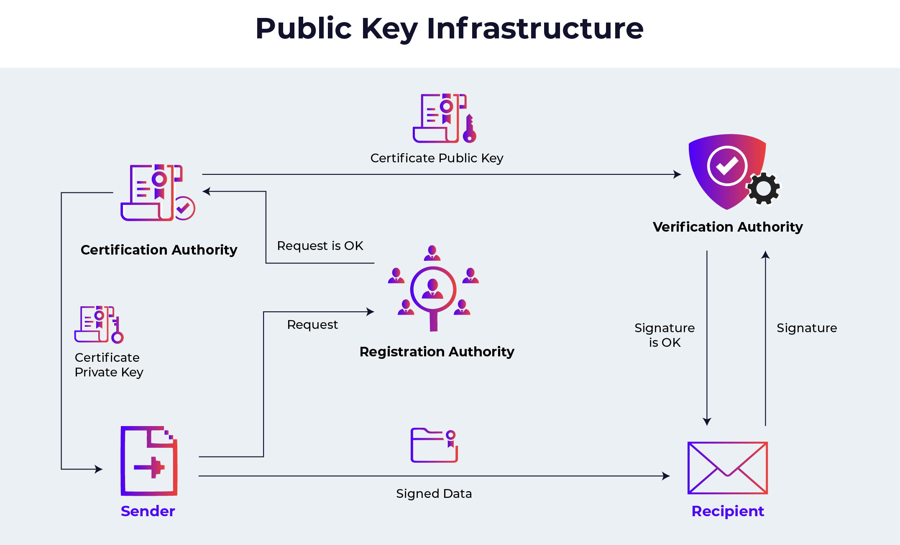
Diagram: How Certificate Authentication Works

Slide 5
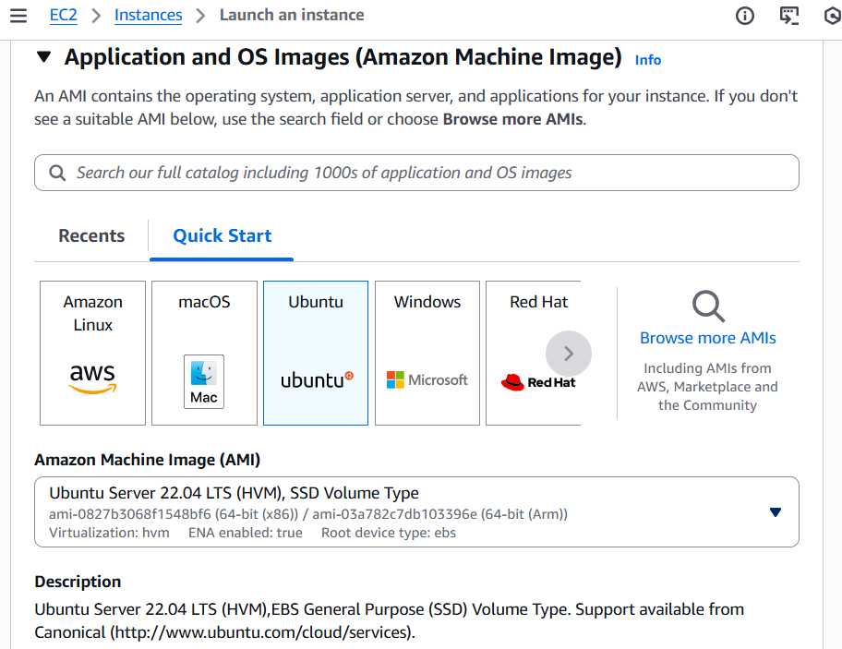
Adding a certificate to a VPN
Step 1: Now Create Another one EC2 Instance

Slide 6
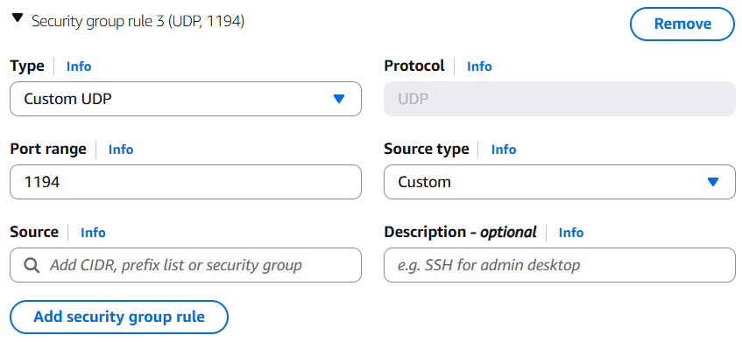
Modifiy the Nerwork setting
SSH is mandatory
Add security group rule
  Type - Custom UDP
  Port Range – 1194
  Source type – Anywhare
  Now Lunch Instance

Slide 7
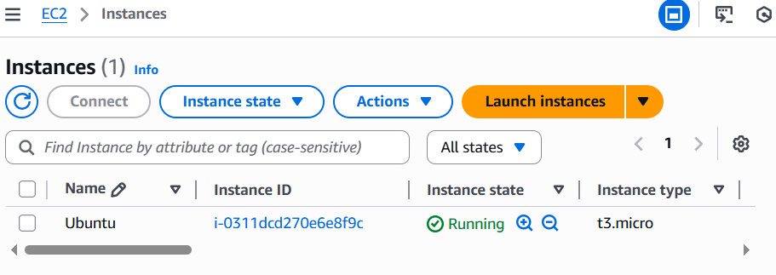
New EC2 instance Created
Step 2 : Connect to instance
Copy the Public IPv4 address (13.214.175.82)
Open Putty Application
in Putty add Host Name / IP Address (ubuntu@13.214.175.82)

Slide 8
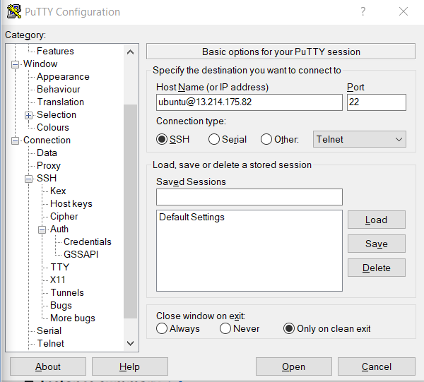

Slide 9
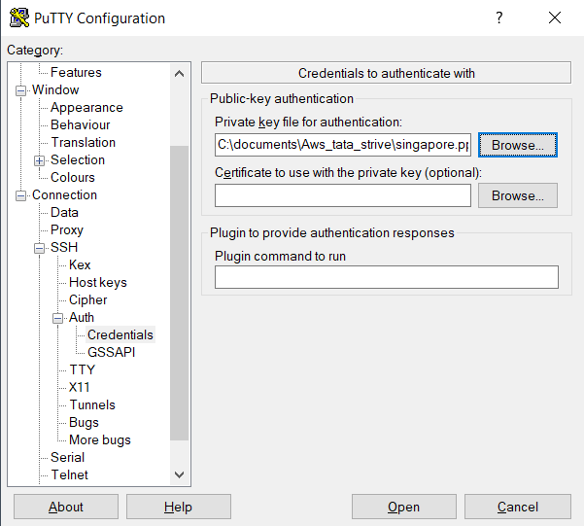
Go to Connection + SSH + Auth + Credentials
Open Credential + browse the .ppk file
Open + Accept and Continue

Slide 10
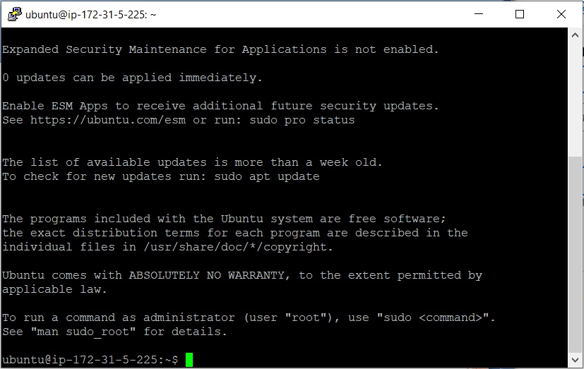
Opned new terminal interface

Slide 11
Step 3: Every time we need to Update the instance
- cmd sudo apt-get update
Step 4: Install the OpenVPN
  Cmd : sudo apt-get install openvpn
What the command does
- sudo
Runs the command with administrator (root) permissions.
- apt-get
Package manager used to install software on Ubuntu.
- install openvpn
Tells Ubuntu to download and install the OpenVPN client + service.

Slide 12
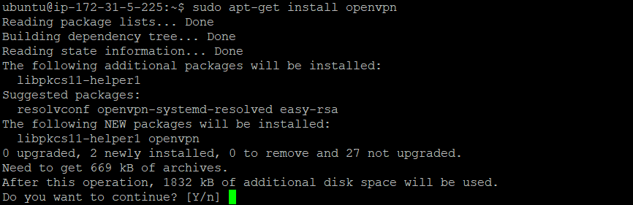
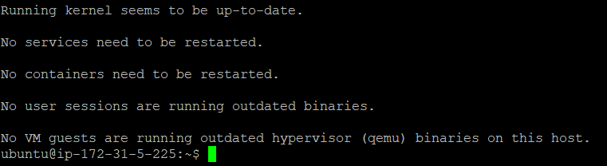
Every thing will be installed

Slide 13
Step 5: This command generates a shared secret key called ta.key
used for:
- Cmd : openvpn --genkey tls-auth ta.key
TLS Authentication (HMAC Security Layer)
Protects your VPN server from unauthorized connections
Prevents port-scanning and DDoS attacks
Adds another security layer on top of certificates
This key is required on both server and client for a successful VPN connection.
ta.key file will generated
find the ta.key file
- cmd : cd /etc/openvpn/

Slide 14

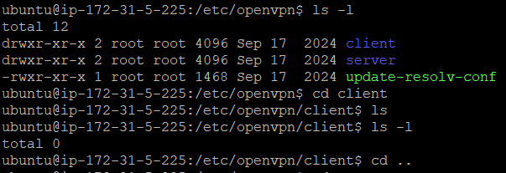

No created ta.key
-cmd : sudo openvpn –genkey tls-auth ta.key
Now its created ta.key file

Slide 15
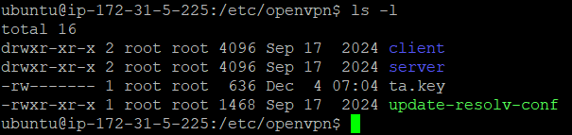
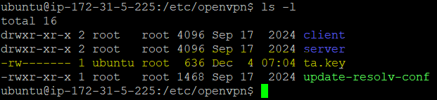
If the owner is root we con not copy the file
Then the owner with using chown
- cmd : sudo chown ubuntu ta.key
- Now its changed the Owner, you can use Now

Slide 16
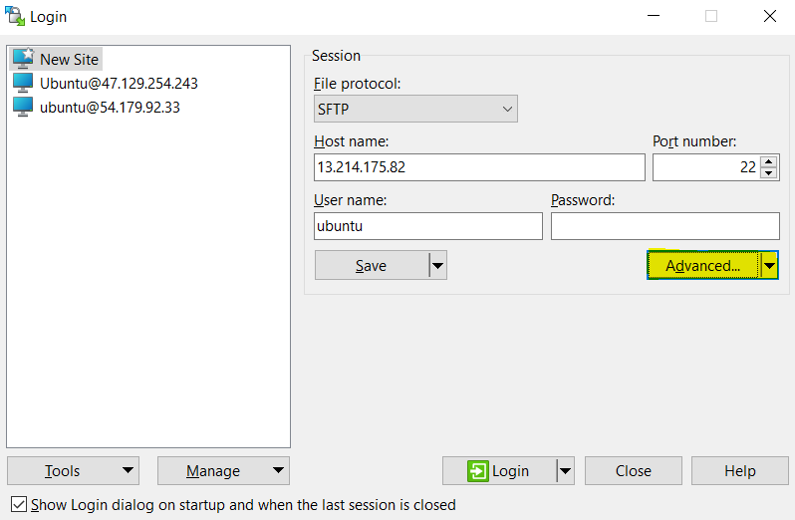
Step 6: Open the Win SCP
- Go to EC2 instance Then copy the Public IPv4 address
( 13.214.175.82 )

Slide 17
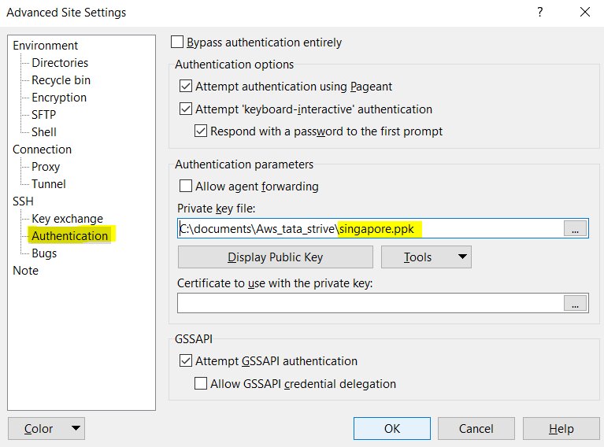
- Go to Advanced + Authentication + add the .ppk file
- Accept and login

Slide 18
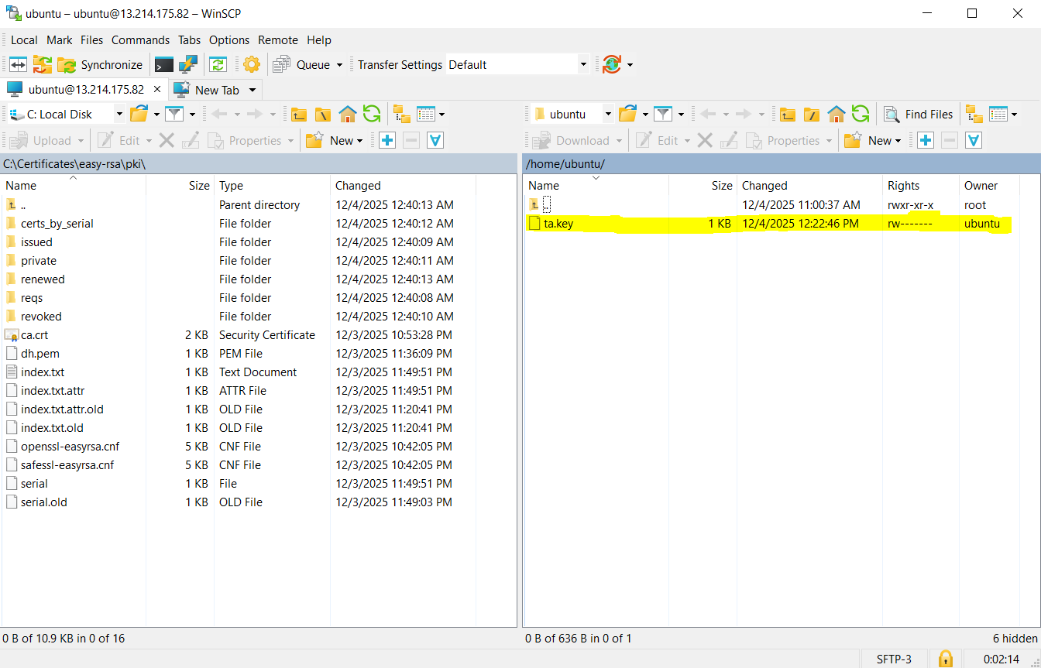

Slide 19
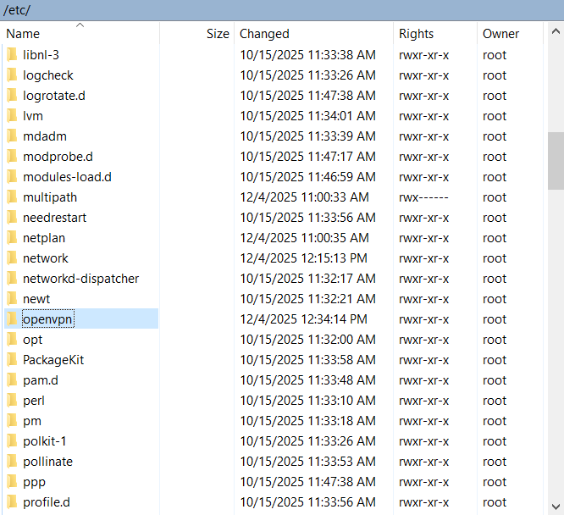
- Go to etc + openvpn

Slide 20
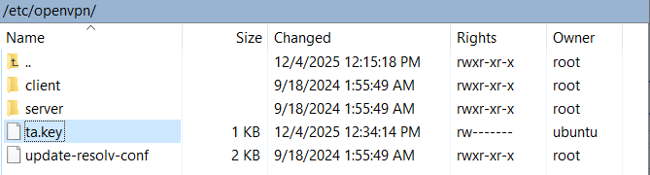
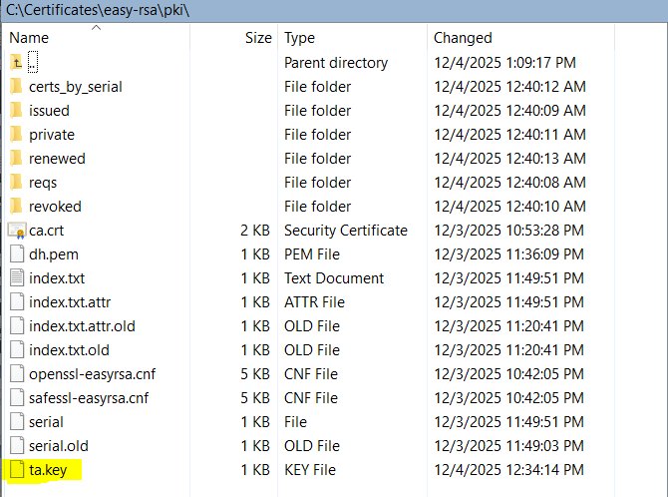
- Then copy the ta.key file
- past in ta.key in certificate

Slide 21
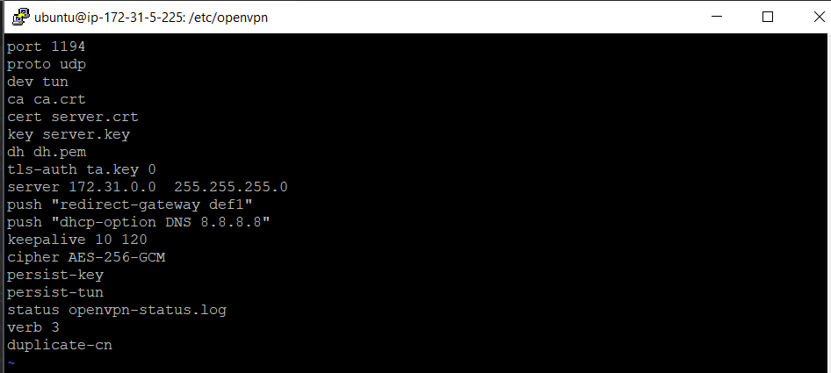
Step 7: Now we need to create Server Configuration
TLS authentication key (ta.key) and changed ownership, the next step is to create the OpenVPN server configuration file.
-cmd : sudo vi server.conf
add code

Slide 22


Step 8: Now we enable the IP forwording
- cmd: sudo sysctl -w net.ipv4.ip_forward=1
This command temporarily enables IP forwarding in Linux.
IP forwarding is required so that VPN clients can access the internet or your internal network through the EC2 server.
Important:
This command works only until the system reboots. After reboot, it will reset unless we make it permanently

Slide 23
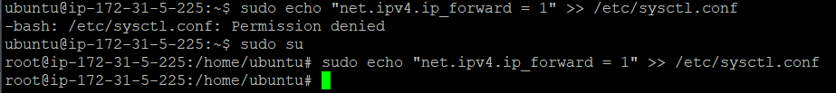
Step 9: Now we enable the system configuration file
- cmd : sudo su ( su is Super User)
- cmd : sudo echo "net.ipv4.ip_forward = 1" >> /etc/sysctl.conf
Step 9: Network Card Configuration
- cmd : sudo iptables -t nat -A POSTROUTING -s 172.31.0.0/24 -o ens5 -j MASQUERADE

Slide 24
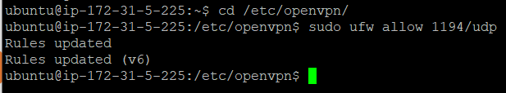
Step 10: Now allow the port number 1194 in firewal
-- cmd : sudo ufw allow 1194/udp
You are allowing VPN clients to reach your OpenVPN server through port 1194. Without this, the VPN server will start, but no client can connect.
-- Now it updated the rules

Slide 25

Step 11: Now we enable the SSH
sudo ufw allow Open SSH is a firewall command used on Ubuntu to allow SSH connections to the server through port 22.
What it does:
  Opens the firewall rule for OpenSSH service
  Ensures you can connect to your EC2 instance using SSH
  Prevents the firewall from blocking your login
Why this command is important?
  If you enable UFW (Ubuntu Firewall) without allowing SSH first, you will get locked out of your EC2 instance.
  So we always run:
-- cmd : sudo ufw allow OpenSSH

Slide 26
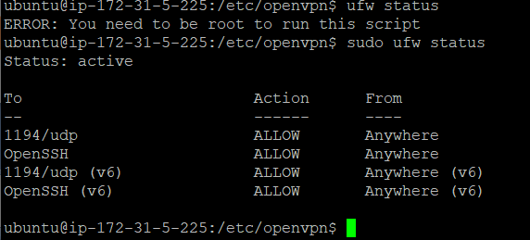
Step 12: Enable ufw by default its disable
-- cmd : sudo ufw enable
After that Need to check the ufw status
Server Configuration is completed

Slide 27
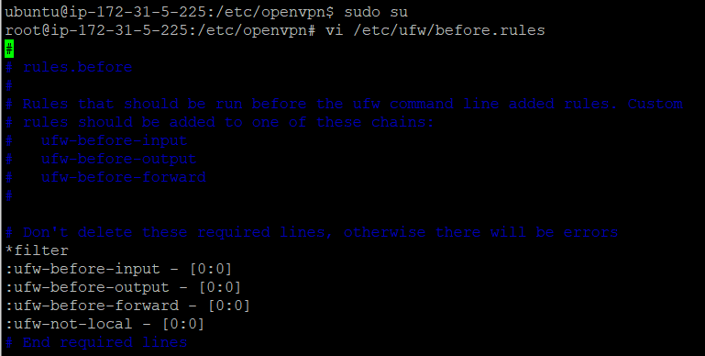
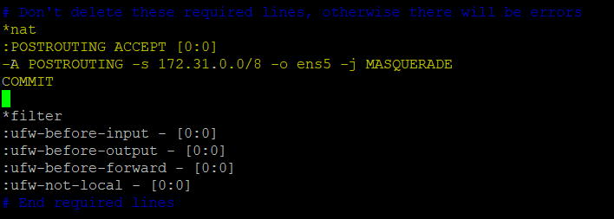
Step 13: Edit /etc/ufw/before.rules to add NAT rules before the *filter section:

Slide 28
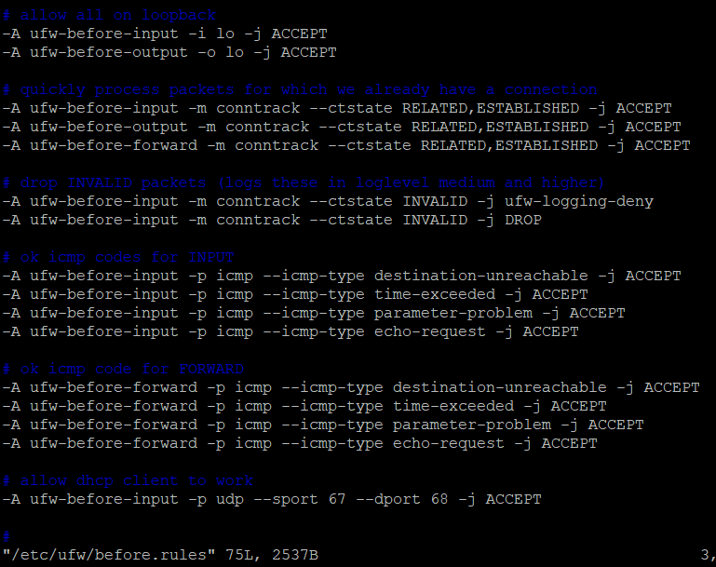

Slide 29
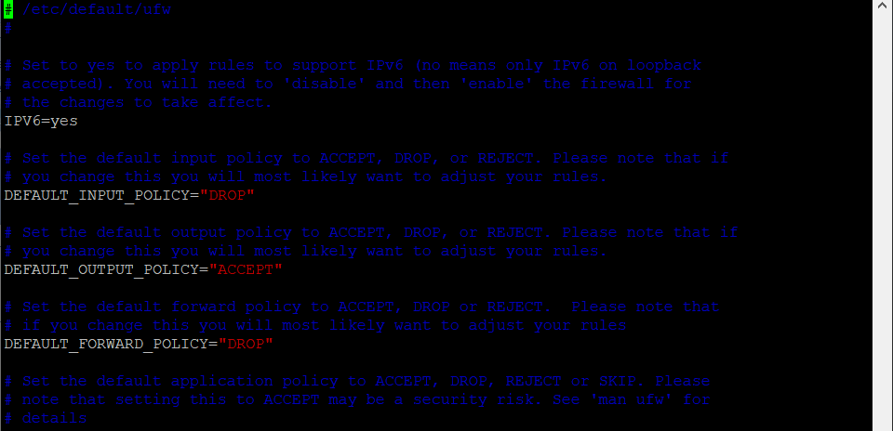
Update /etc/default/ufw
-- cmd : vi /etc/default/ufw

Slide 30
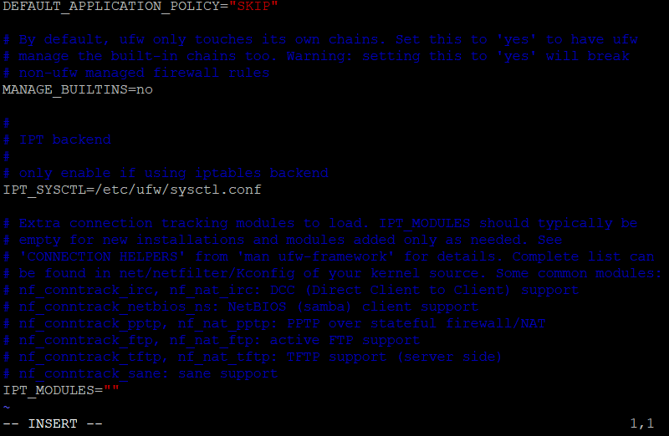

Slide 31
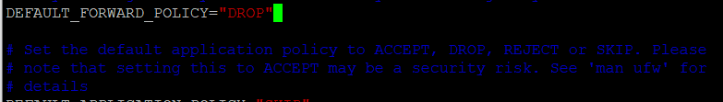
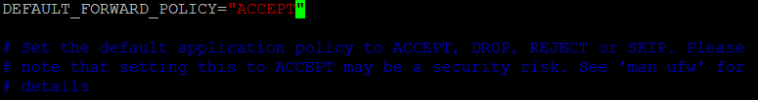
Step 14: Go to DEFAULT_FORWARD_POLICY=“DROP“
Change to DEFAULT_FORWARD_POLICY=“DROP“ to “ ACCEPT”
Now start the VPN Server
-- cmd: cd /etc/openvpn/
-- sudo systemctl start openvpn@server

Slide 32
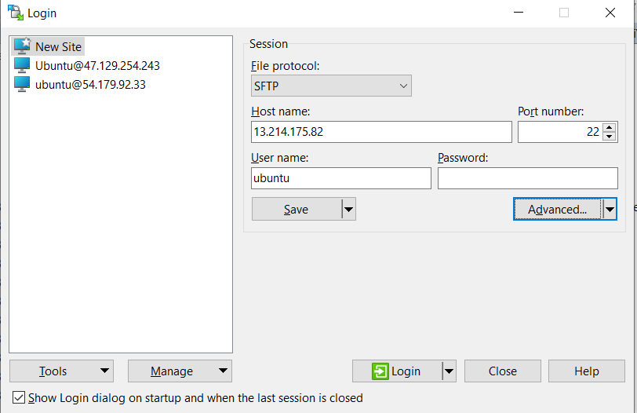
Start the WinSCP

Slide 33
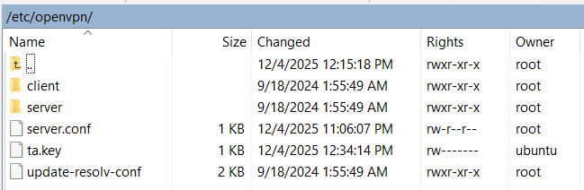
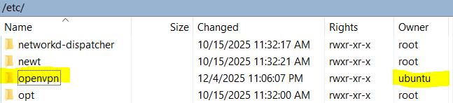
Step 15: Open the Openvpn ( /etc/openvpn/)
Step 16: We cont modify the root folder then now we change the owner permission
Now refresh the WinSCP and check owner permission update or not

Slide 34
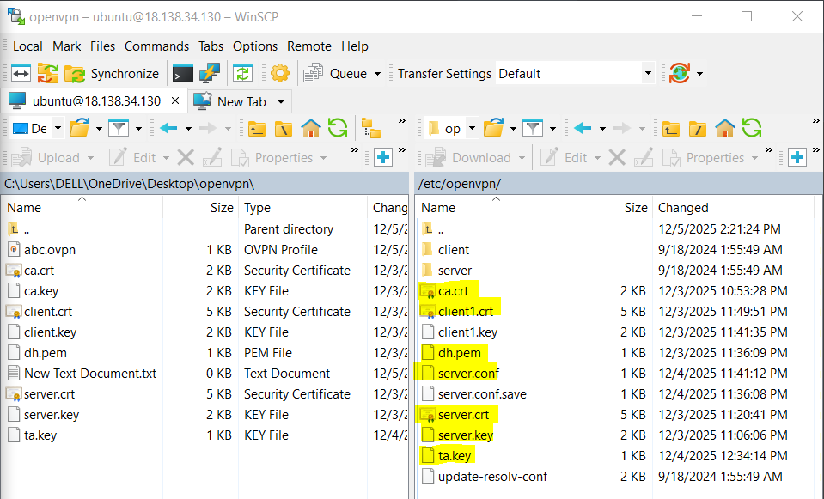
Step 17: Then we copy the files form local certificate
Certificate are:
-- CA, Server.crt, Server.key, ta.key, dh.pem

Slide 35
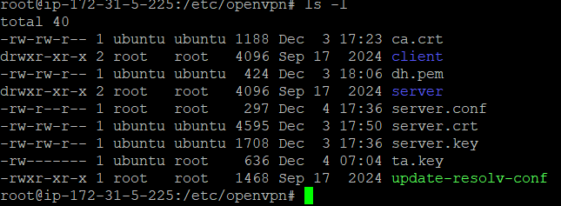
Step 18: Now start the server
--cmd: sudo systemctl start openvpn@server

Slide 36
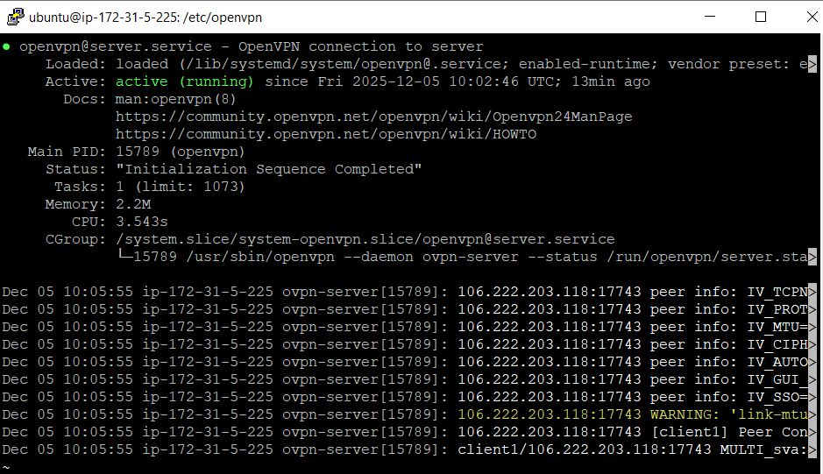
Step 19: Then now check the status of openvpn server
--cmd: sudo systemctl status openvpn@server

Slide 37

Step 20: Download the install the openvpn https://openvpn.net/client/

Slide 38
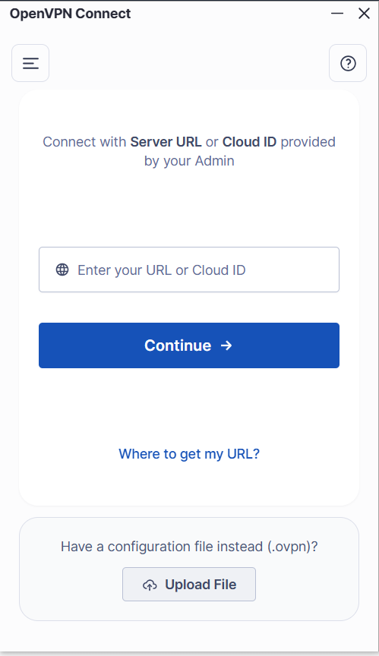
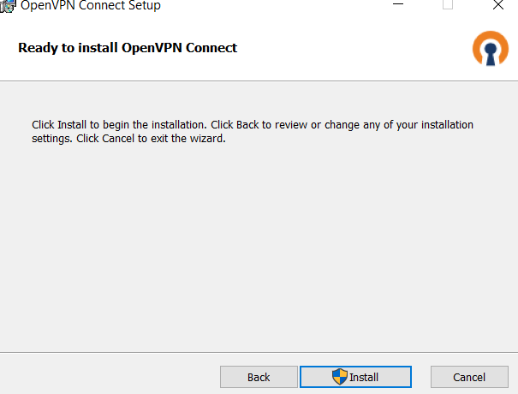

Slide 39
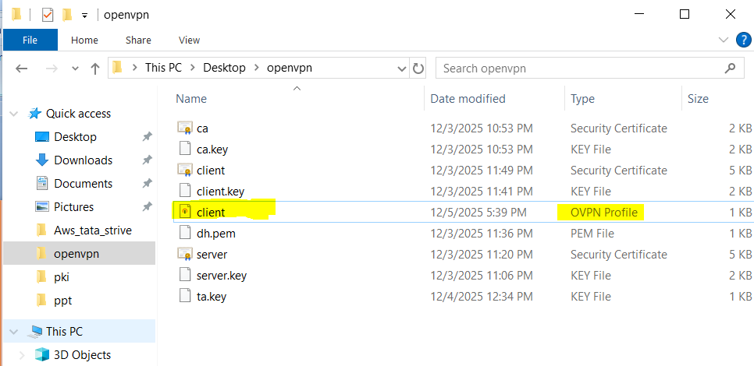
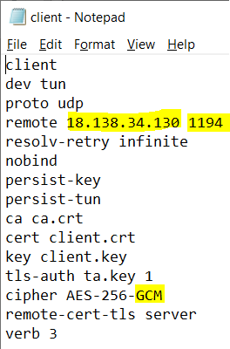
Step 21 : configure the client server
go back to esayrsa floder & create one file
Edit the IP address and post num with , use UDP protocal and save it extension .ovpn (client.ovpn)

Slide 40
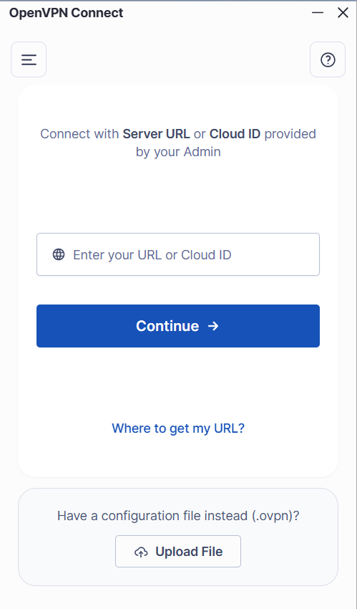
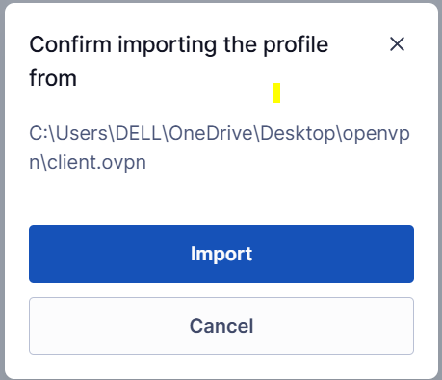
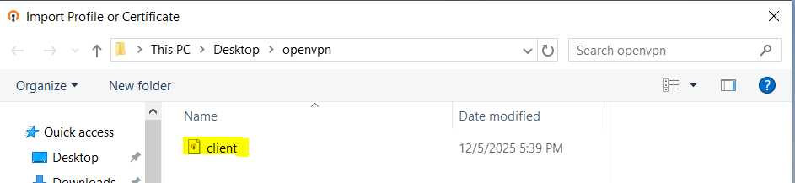
Step 22: Open the open vpn server
Upload the .OVPN file (client.ovpn)
Import file
Now its ready to connet

Slide 41
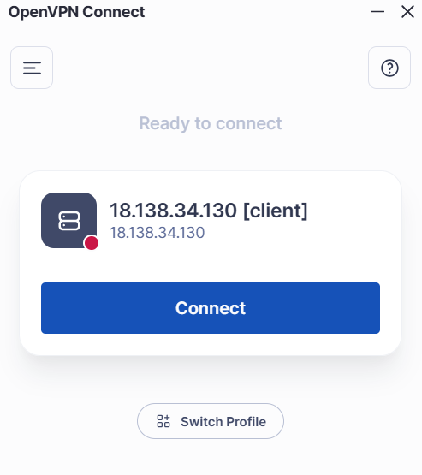
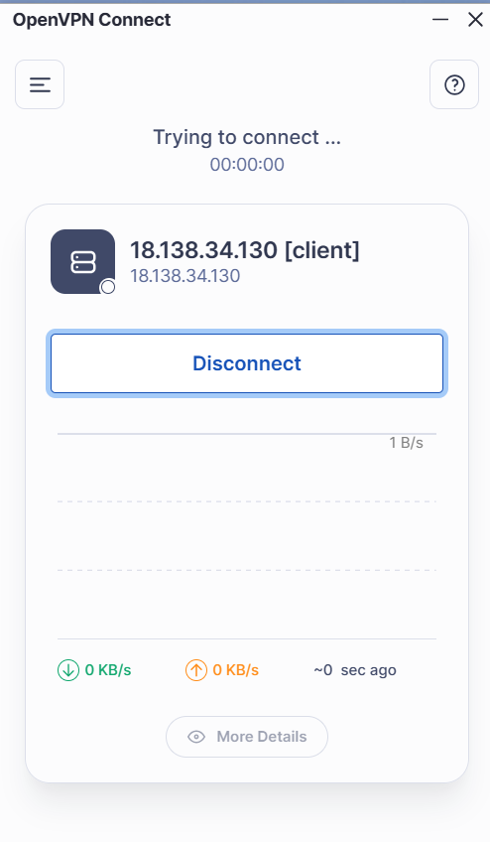
Now its ready to connect
-- Then click to Connect every thing will correct then it will connected securly other wise its not connected

Slide 42
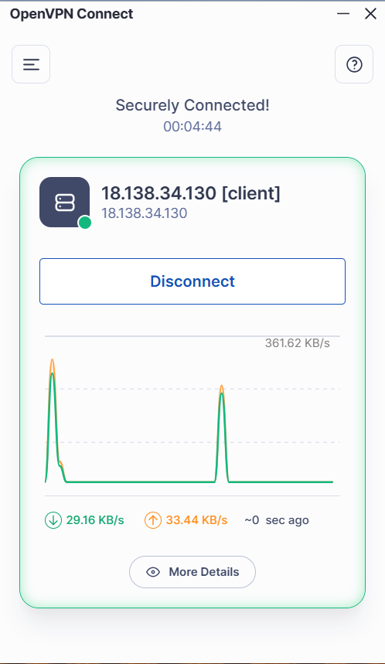
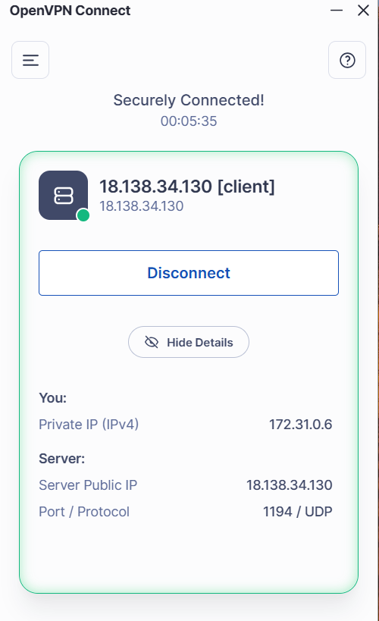
Connected Successfully

Slide 43
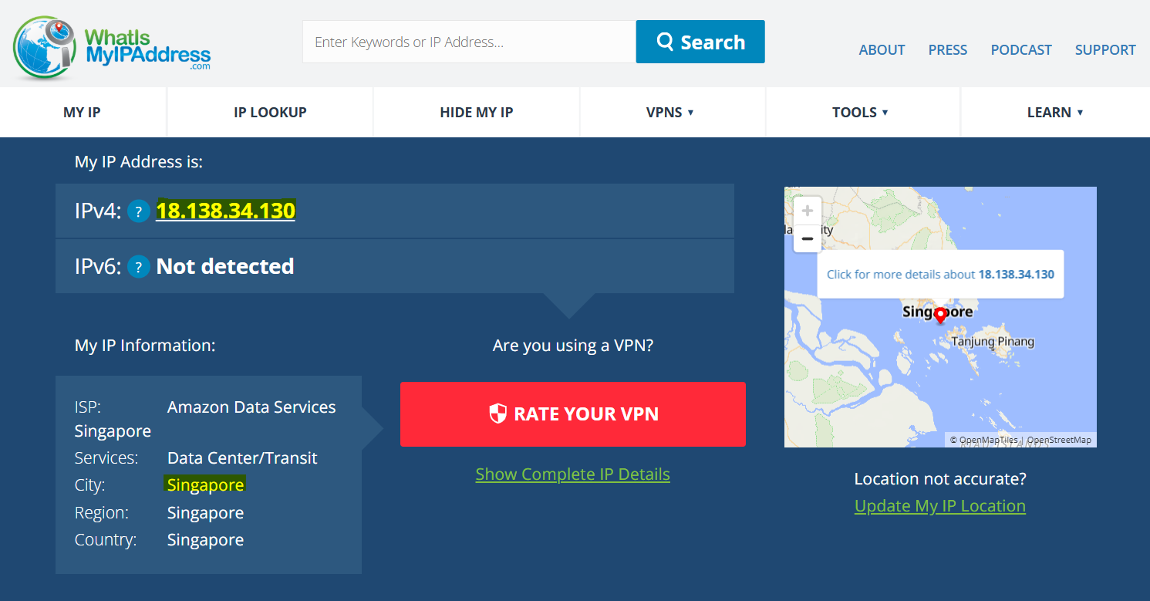
Step 23: Verify it working its properly or not
-- Open My_ip_address https://whatismyipaddress.com/
-- Verify the region and IP address

Slide 44
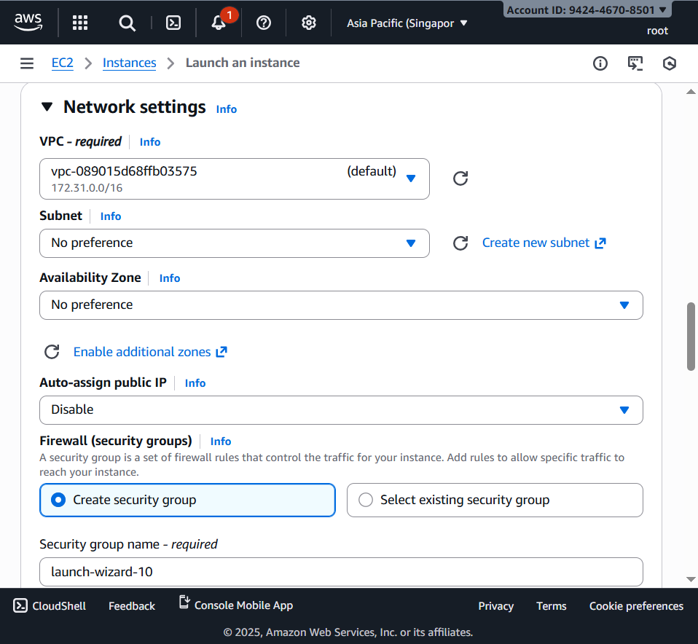
Step 24: Lunch one more instance with disable it Public IP address

Slide 45
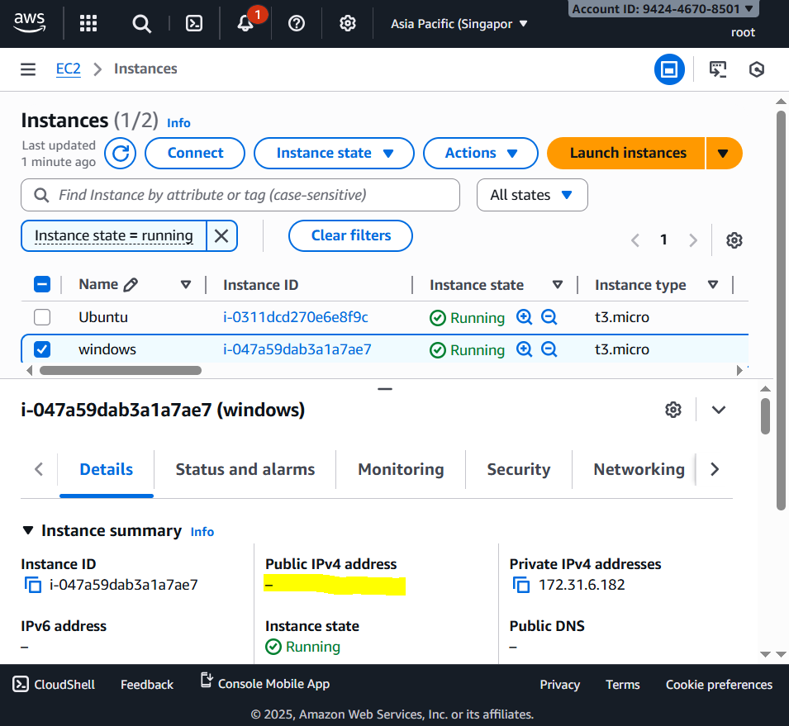

Slide 46
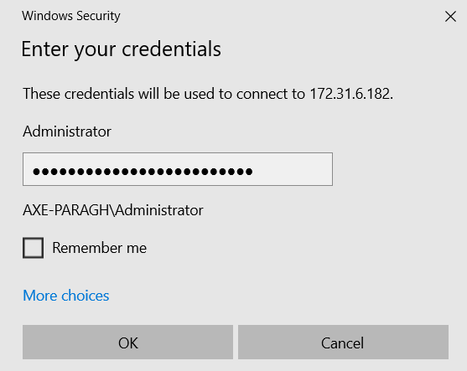

Open the remote Desktop Connection
Get password and Copy

Slide 47

Now its connected without the Public IP address

Slide 48


Now Disconnect and check the IP address

Slide 49

Now we see the changed IP address and your current location

Slide 50
Thank You

